Slide 1
PROJECT – 1
BY Aishwarya and Priyanka

Slide 2
Diwali sales Analysis
PYTHON PROJECT
Python programming language is used
Libraries – Numpy , Pandas , Matplotlib , Seaborn
Jupyter Notebook is used - An open source web application that allows data scientists to create and share documents that include live code, equations, and other multimedia resources.
Local host is used - For example, if you set up a web server on your computer and access it using a web browser with the address "http://localhost," you would be connecting to the server running on your own machine.

Slide 3
Objective
Improve Customer experience by analyzing sales data
Increase revenue

Slide 4
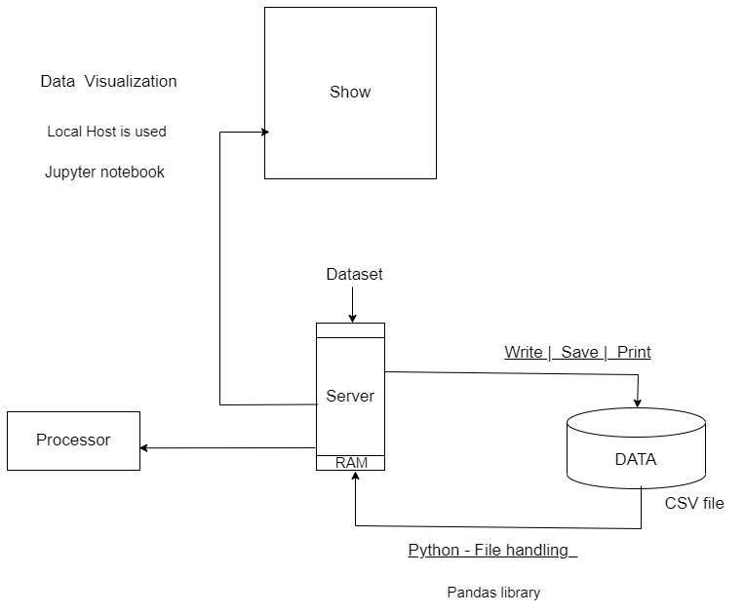

Slide 5
STEPS
Data Cleaning
Exploratory Data Analysis Process (EDA) –
(Gender, Age, State, Marital Status , Occupation, Product Category)
3. Conclusion

Slide 6
FUNCTIONS :
Importing Libraries :
For installing packages use:
Ex. !pip install pandas
import numpy as np
import pandas as pd
import matplotlib.pyplot as plt # visualizing data
%matplotlib inline
import seaborn as sns
Data is import from CSV file , using file handling concept in python
df=pd.read_csv(r'C:\Users\aishwarya\OneDrive\Desktop\DataAnalysis\Python_Diwali_Sales_Analysis 1\Diwali Sales Data.csv',encoding='unicode_escape')
# to avoid encoding error , use 'unicode_escape'
drop unrelated/blank columns
df.drop(['Status','unnamed1'],axis=1,inplace=True)
check for null values
pd.isnull(df).sum()
drop null values
df.dropna(inplace=True)

Slide 7
change data type
df['Amount']=df['Amount'].astype('int')
to check the data type is changed or not
df['Amount'].dtypes
to see how many columns are there in data type
df.columns
rename column name
df.rename(columns={'Marital_Status':'Shaadi'})
describe() methods returns description of the data in the dataframe(i.e. count,mean,std,etc)
df.describe()
use describe() for specific columns
df[['Age','Orders','Amount']].describe()
df.shape - To know how many rows and column
df.head() - To know default first 5 rows if you want to see more rows then add no in () brackets
df.info() - To know all info like column name, data types, memory usage ,null value count

Slide 8
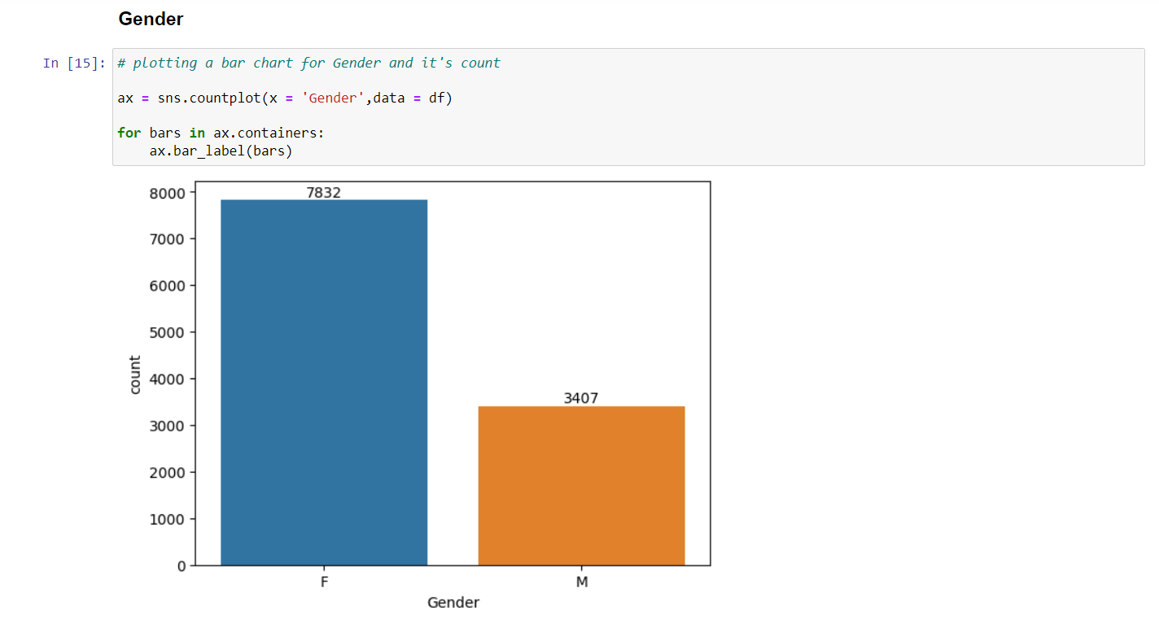

Slide 9
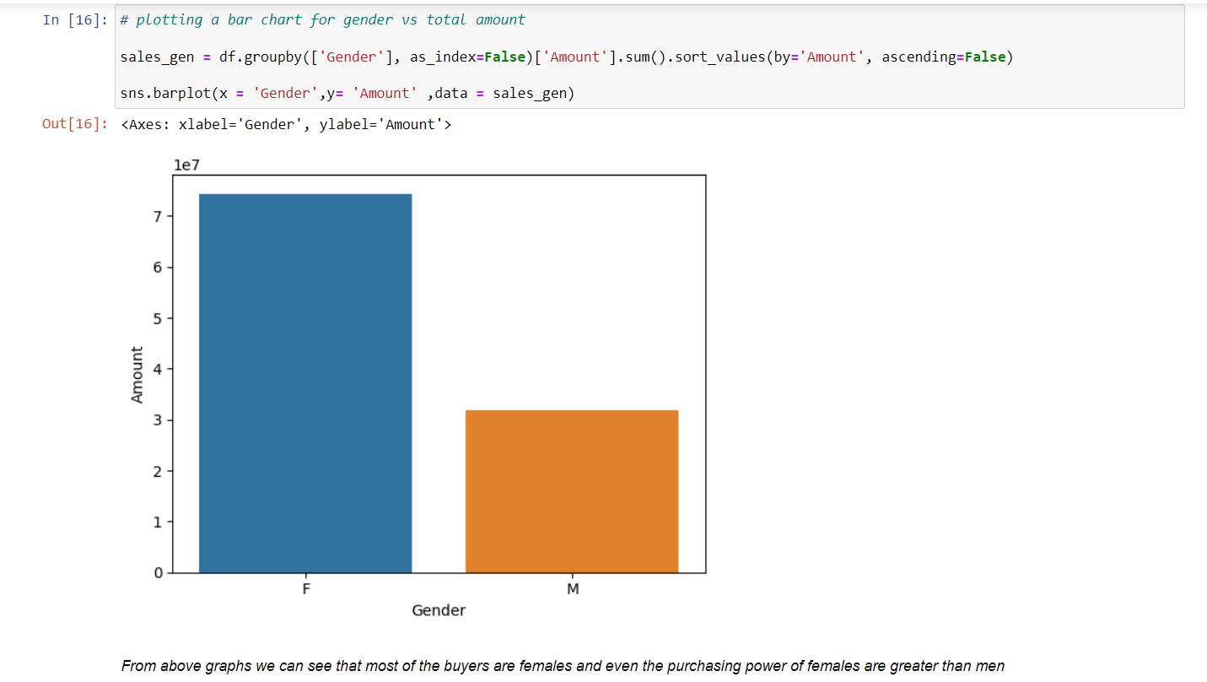

Slide 10
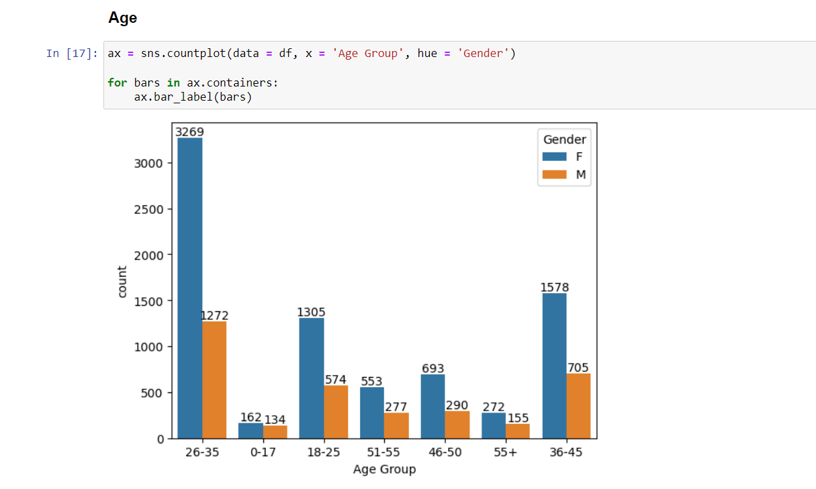

Slide 11
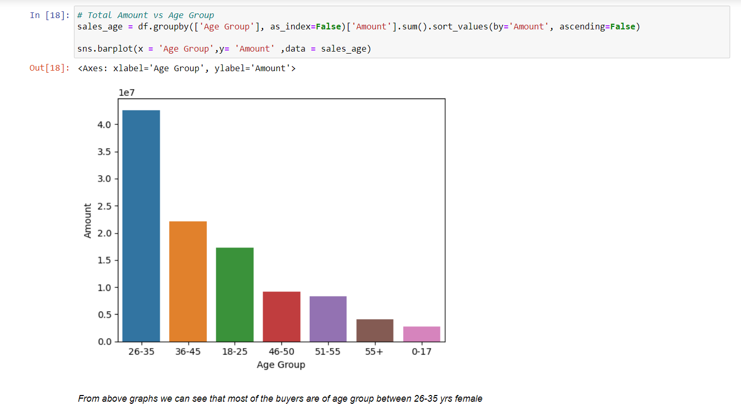

Slide 12
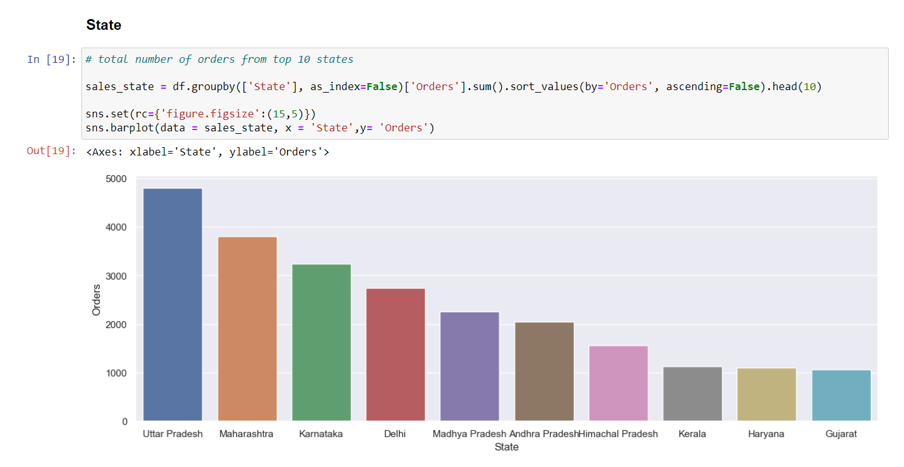

Slide 13
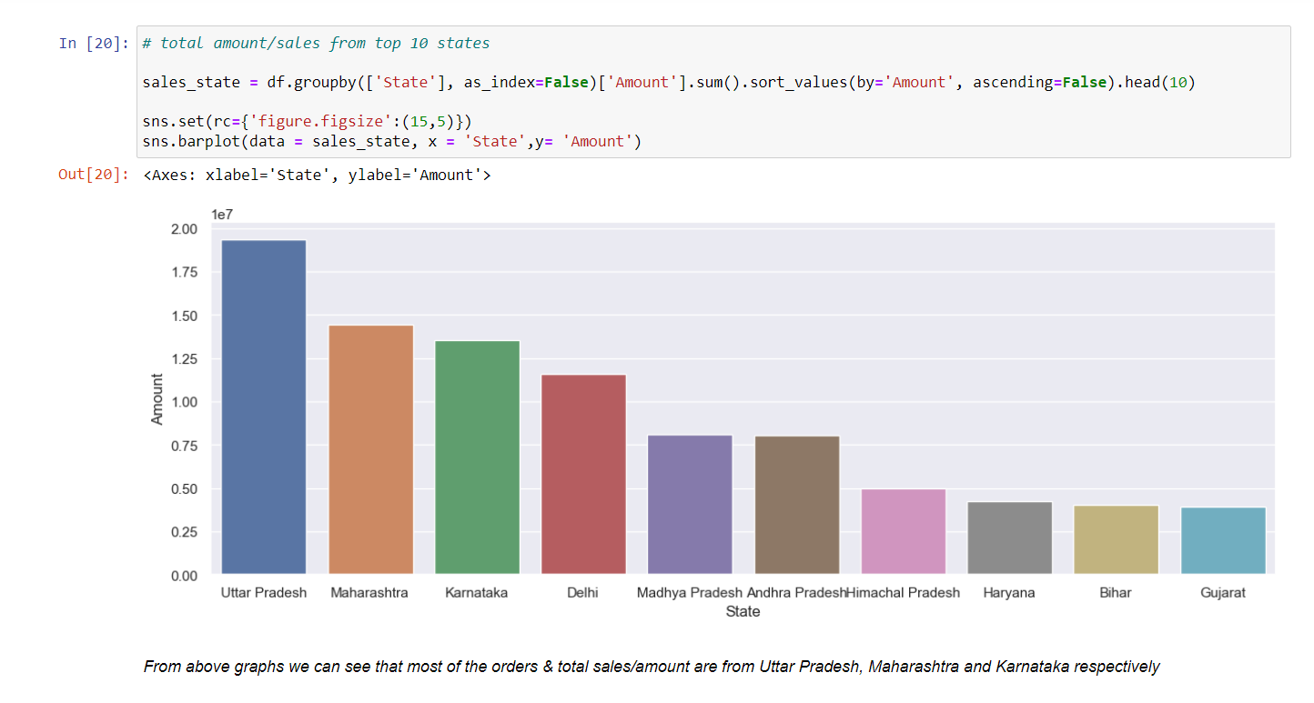

Slide 14
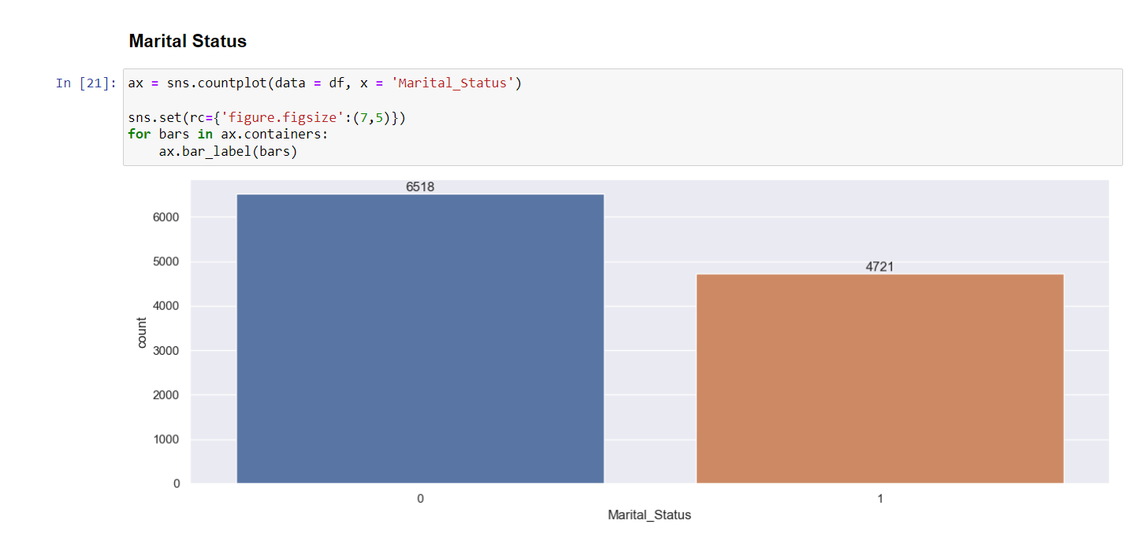

Slide 15
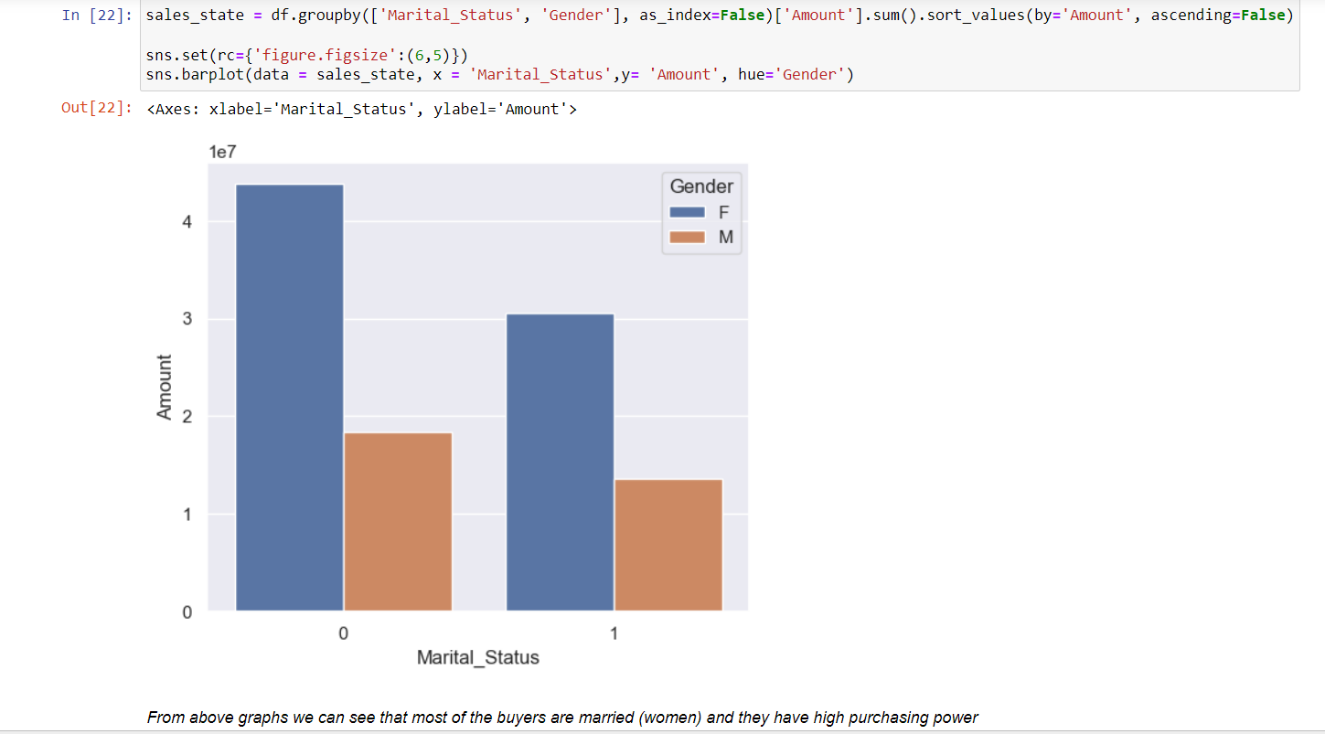

Slide 16
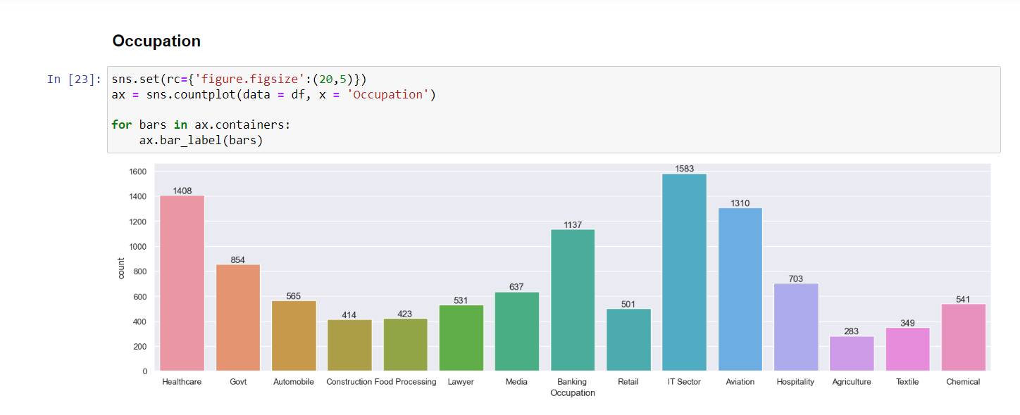

Slide 17
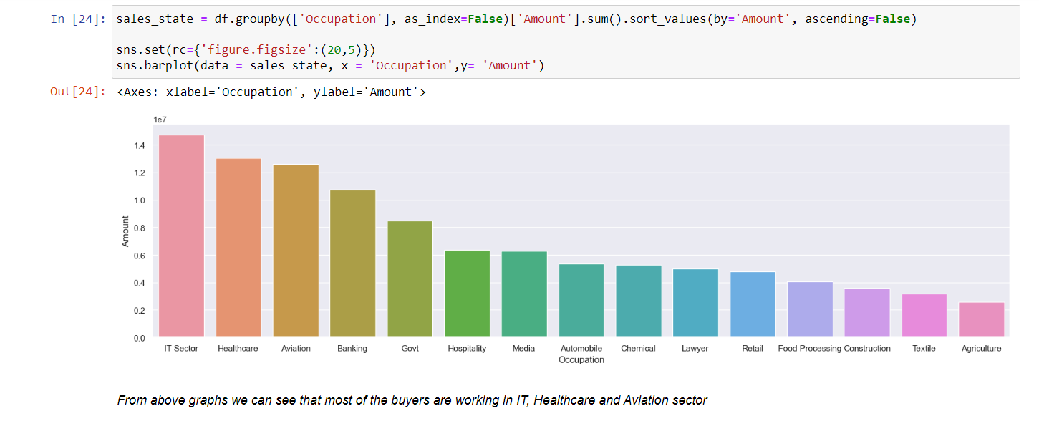

Slide 18
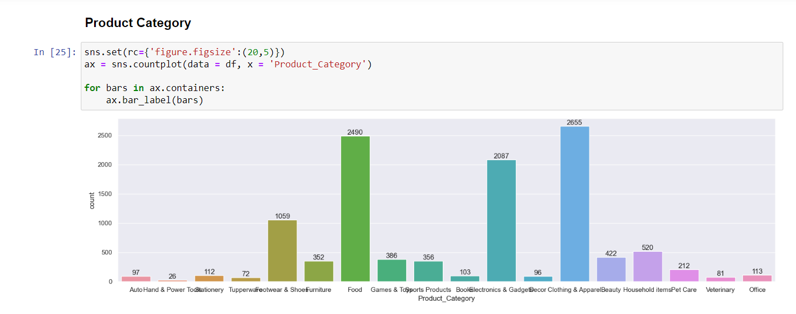

Slide 19
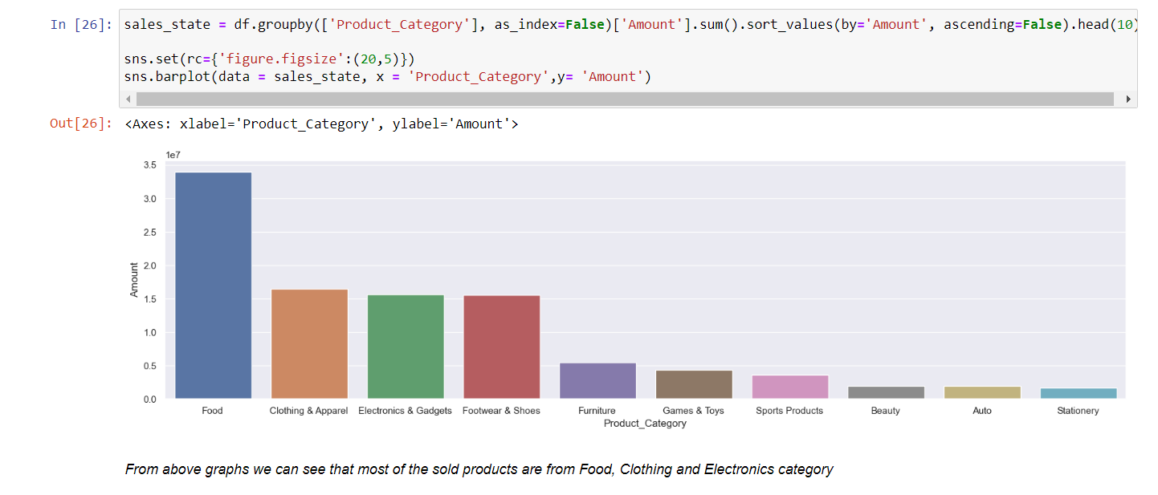

Slide 20
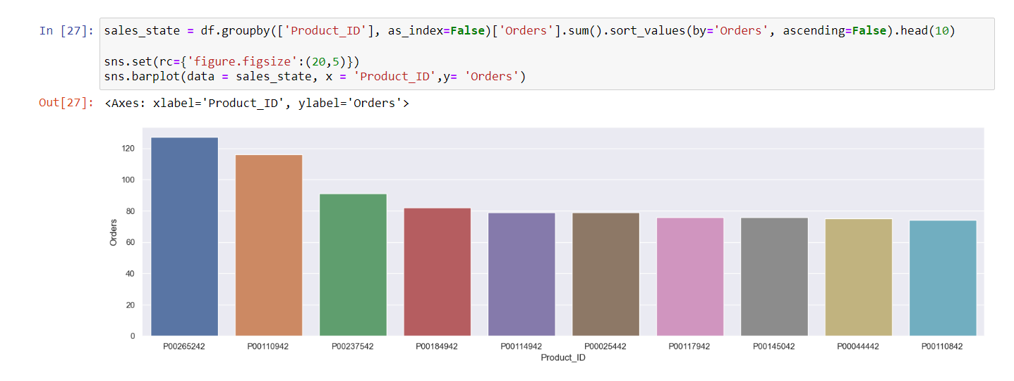

Slide 21
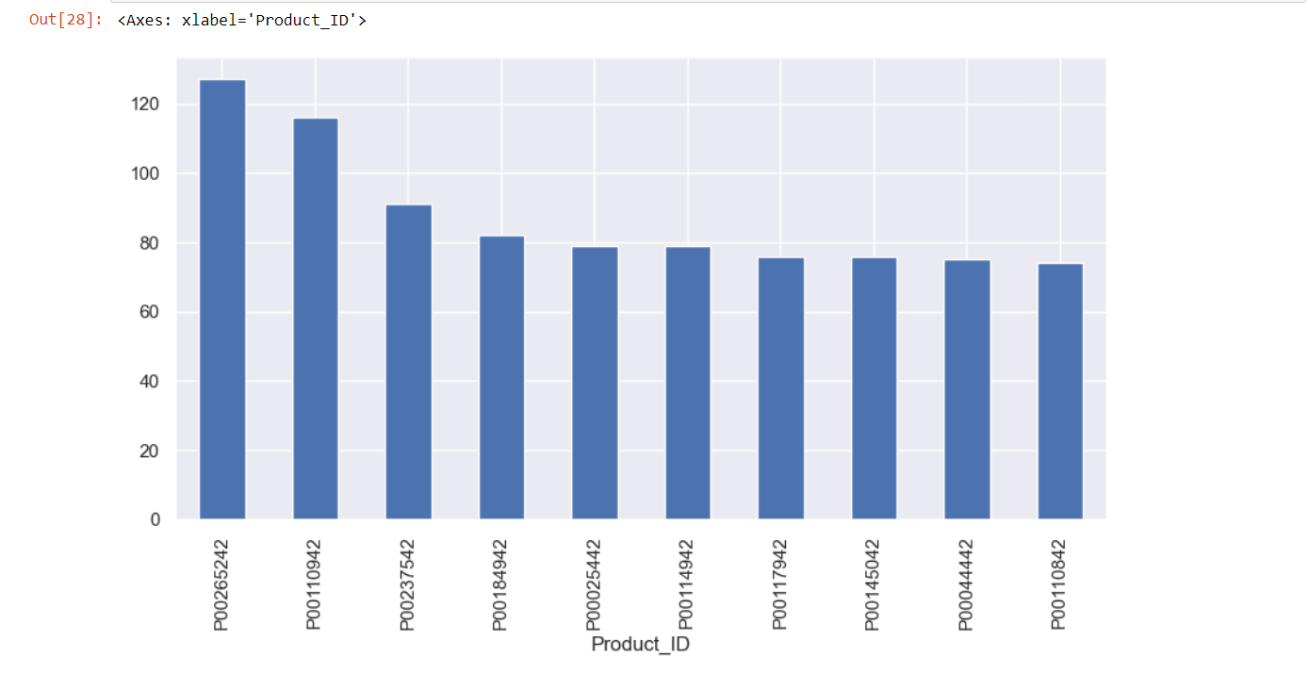

Slide 22
Conclusion:
Married women age group 26-35 yrs from UP, Maharashtra and Karnataka working in IT, Healthcare and Aviation are more likely to buy products from Food, Clothing and Electronics category
complete project on
YouTube: https://youtu.be/KgCgpCIOkIs
GitHub: https://github.com/rishabhnmishra/Python_Diwali_Sales_Analysis

